Slide 1

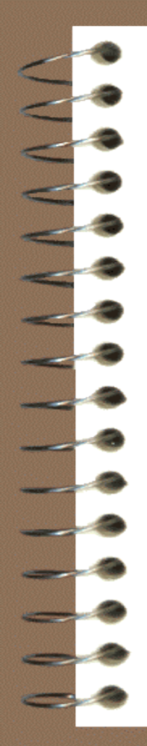
Spectrochemical methods

Slide 2
Spectrophotometry
Spectroscopy :
the science that deals with the interaction of electromagnetic radiation with matter.
Spectrometry :
denotes the quantitative measurement of the intensity of electromagnetic radiation at one or more wavelengths with photoelectric detector.
Spectrum (pl. spectra) :
a display of the intensity of radiation emitted,
absorbed, or scattered by a sample versus a
quantity related to photon energy(E), such as
wave length(λ) or frequency(ν).
Intensity
wave length(λ, nm)
or frequency(ν, cm^{–1}).
Spectrum

Slide 3
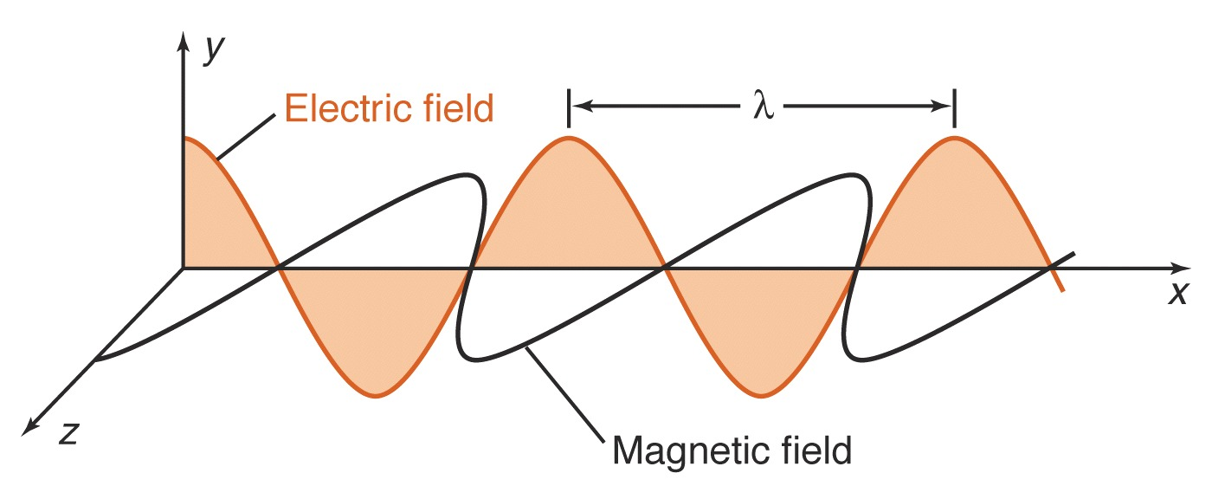
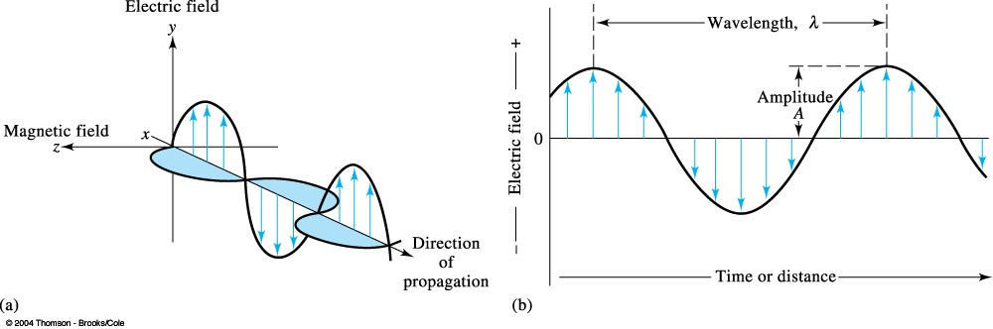
Plane-polarized electromagnetic radiation showing the electric field, and the direction of propagation.
Electric field component of plane-polarized electromagnetic radiation.

Slide 4
Electromagnetic Radiation
Electromagnetic radiation, or light, is a form of energy whose behavior is described by the properties of both waves and particles.
The optical properties of electromagnetic radiation, such as diffraction, are explained best by describing light as a wave.
Many of the interactions between electromagnetic radiation and matter, such as absorption and emission, however, are better described by treating light as a particle, or photon.
The dual models of wave and particle behavior provide a useful description for electromagnetic radiation

Slide 5

Electromagnetic Radiation
Electromagnetic radiation consists of oscillating electric and magnetic fields that propagate through space along a linear path and with a constant velocity .
In a vacuum, electromagnetic radiation travels at the speed of light, c, which is 2.99792 x 10⁸ m/s.
Oscillations in the electric and magnetic fields are perpendicular to each other, and to the direction of the wave’s propagation.
Normally, electromagnetic radiation is unpolarized, with oscillating electric and magnetic fields in all possible planes oriented perpendicular to the direction of propagation.
The interaction of electromagnetic radiation with matter can be explained using either the electric field or the magnetic field.
The oscillating electric field is described by a sine wave of the form

Slide 6
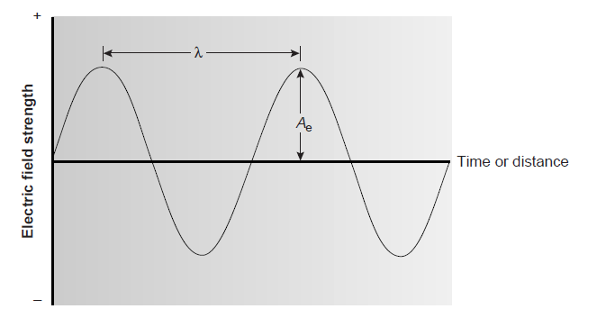
Electromagnetic Radiation
where E is the magnitude of the electric field at time t, A_{e} is the electric field’s maximum amplitude, ν is the frequency, or the number of oscillations in the electric field per unit time, and Φ is a phase angle accounting for the fact that the electric field’s magnitude need not be zero at t = 0.

Slide 7


Electromagnetic Radiation
An electromagnetic wave is characterized by several fundamental properties, including its velocity, amplitude, frequency, phase angle, polarization, and direction of propagation.
The wavelength of an electromagnetic wave, λ, is defined as the
distance between successive maxima, or successive minima .
For ultraviolet and visible electromagnetic radiation the wavelength is usually expressed in nanometers (nm, 10^{–9} m), and the wavelength for infrared radiation is given in microns (μm, 10^{–6} m).
The wavelength depends on the electromagnetic wave’s velocity.
wavenumber, which is the reciprocal of wavelength

Slide 8
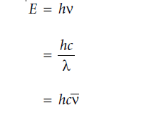
Absorption of energy
When a sample absorbs electromagnetic radiation it undergoes a change in energy.
When a photon is absorbed by a sample, it is “destroyed,” and its energy acquired by the sample. The energy of a photon, in joules, is related to its frequency, wavelength, or wavenumber by the following equations
where h is Planck’s constant, which has a value of 6.626 x10^{–34} J · s.
1 erg = 10 ^{–7} J
1 eV = 1.6021 × 10 – ¹⁹ J

Slide 9
power
The flux of energy per unit time (P).
intensity
The flux of energy per unit time per area (I).
photon
A particle of light carrying an amount of energy equal to hν.
electromagnetic spectrum
The division of electromagnetic radiation on the basis of a photon’s energy.

Slide 10
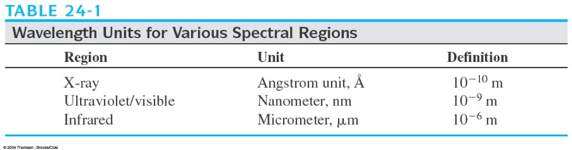
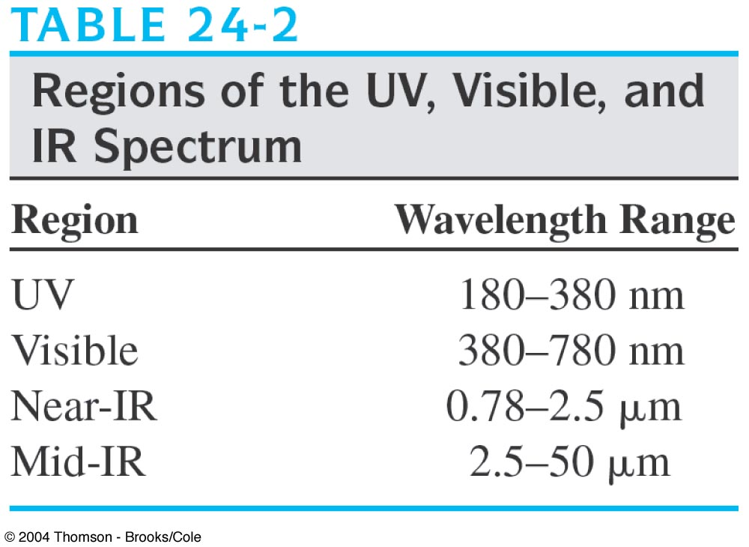

Slide 11
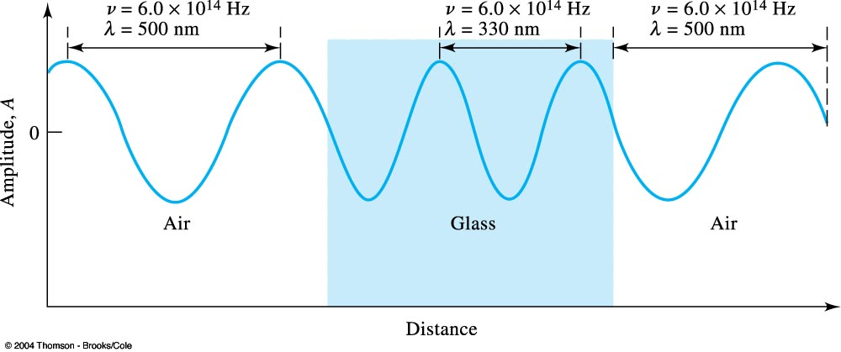
Change in wavelength as radiation passes from air into a dense glass and back to air. Note that the wavelength shortens by nearly 200 nm, or more than 30%, as it passes into glass; a reverse change occurs as the radiation again enters air.

Slide 12
Regions of EM spectrum
Designation Wavelength Energy or Transition
range wave number
Cosmic ray
γ-ray
X-ray
Vacuum UV
near UV
Visible
Near IR
Middle IR
Far IR
Microwave
Radio wave
10 ^{– 12} m
10 ^{– 11} m >2.5 × 10⁵ eV
10 ^{– 8} m 124 eV
180 × 10 ^{– 9} m 7 eV
380 × 10 ^{– 9} m 3.3 eV
780 × 10 ^{– 9} m 1.6 eV
2500 × 10 ^{– 9} m 4000 cm ^{– 1}
50 × 10 ^{– 6} m 200 cm ^{– 1}
10 ^{– 3} m 10 cm ^{– 1}
0.3 m
Nuclear
K,L shell electron
Middle shell
Valence electron
Molecular electron
Molecular vibration
Molecular vibration
Molecular rotation
Molecular rotation
Electron, & nuclear
spin

Slide 13
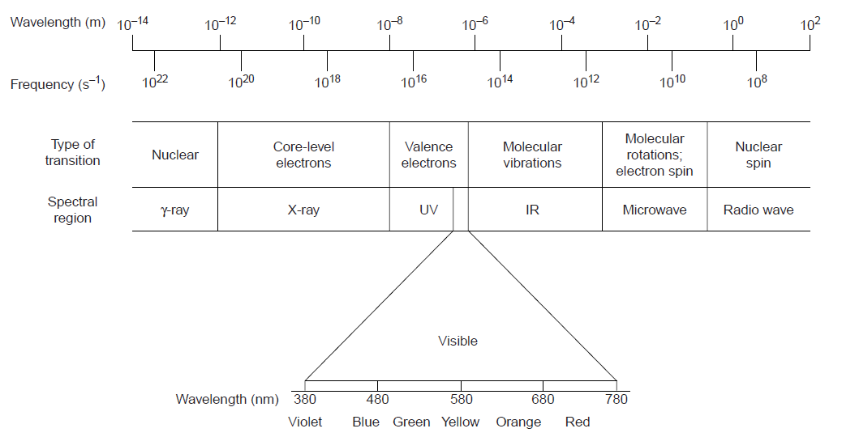

Slide 14
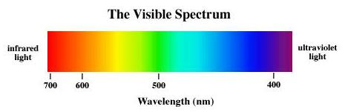
The visible spectrum
Wavelength Color absorbed Color observed
(nm) (complement)
380-420 Violet Green-yellow
420-440 Violet-blue Yellow
440-470 Blue Orange
470-500 Blue-green Red
500-520 Green Purple
520-550 Yellow-green Violet
550-580 Yellow Violet-blue
580-620 Orange Blue
620-680 Red Blue-green
680-780 Purple Green
ROYG BIV
Red, Orange, Yellow, Green, Blue, Indigo, Violet

Slide 15
Spectroscopy
Spectroscopy is divided into two broad classes.
In one class of techniques, energy is transferred between a photon of electromagnetic radiation and the analyte. e.g. absorption, emission
In the second broad class of spectroscopy, the electromagnetic radiation undergoes a change in amplitude, phase angle, polarization, or direction of propagation as a result of its refraction, reflection, scattering, diffraction, or dispersion by the sample.

Slide 16
Spectroscopy
In absorption spectroscopy the energy carried by a photon
is absorbed by the analyte, promoting the analyte from a lower-energy state to a higher-energy, or excited, state.
The source of the energetic state depends on the photon’s energy.
The absorption of a photon of visible light causes a valence electron in the analyte to move to a higher-energy level.
When an analyte absorbs infrared radiation, on the other hand, one of its chemical bonds experiences a change in vibrational energy.
The intensity of photons passing through a sample containing the analyte is attenuated because of absorption.
The measurement of this attenuation, called absorbance, serves
as our signal.

Slide 17
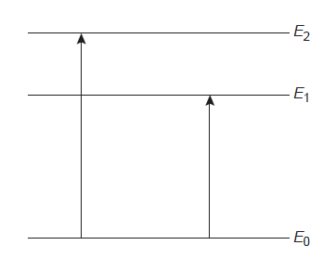
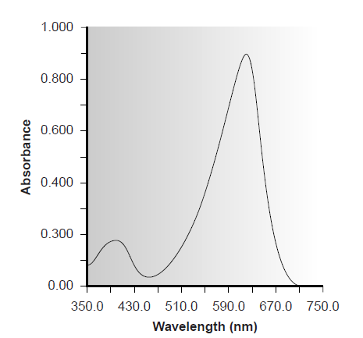
Absorption Spectroscopy
The energy levels have well-defined values (i.e., they are quantized).
Absorption only occurs when the photon’s energy matches the difference in energy, ΔE, between two energy levels.
A plot of absorbance as a function of the photon’s energy is called an absorbance spectrum

Slide 18
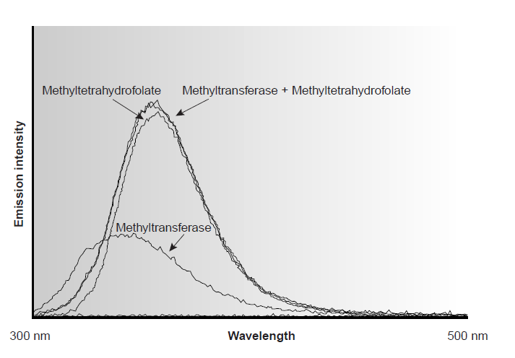
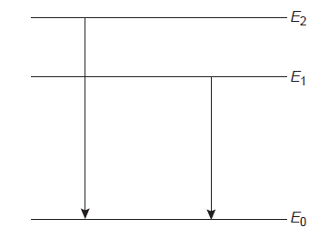
Emission Spectroscopy
Emission of a photon occurs when an analyte in a higher-energy state returns to a lower-energy state.
The higher-energy state can be achieved in several ways, including thermal energy, radiant energy from a photon, or by achemical reaction.
Emission following the absorption of a photon is also called photoluminescence, and that following a chemical reaction is called chemiluminescence.

Slide 19
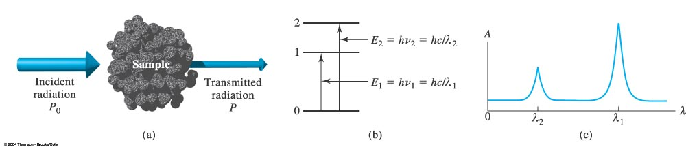
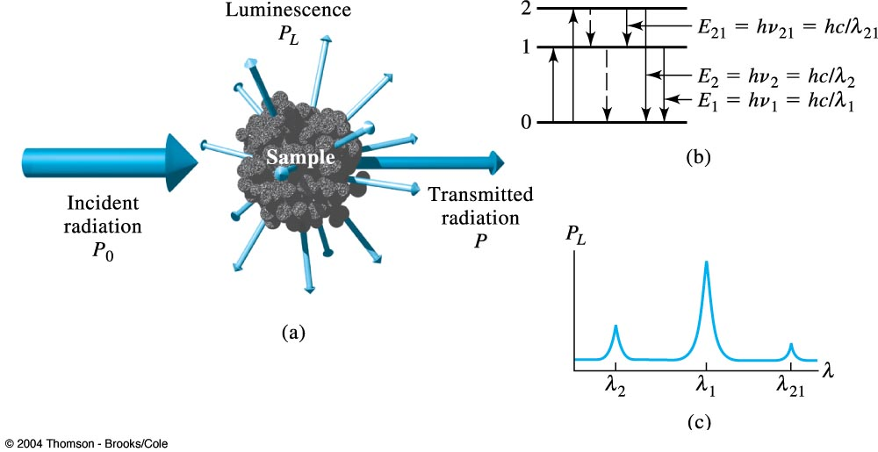
Absorption methods.
Photoluminescence methods.

Slide 20
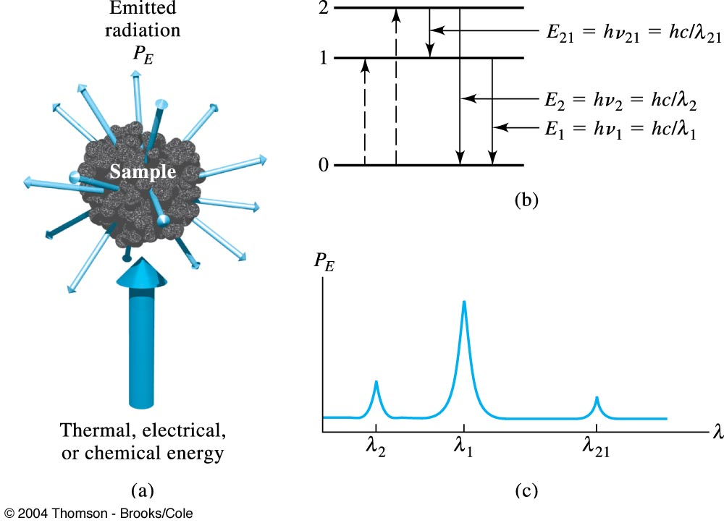
Emission or chemiluminescence processes.

Slide 21
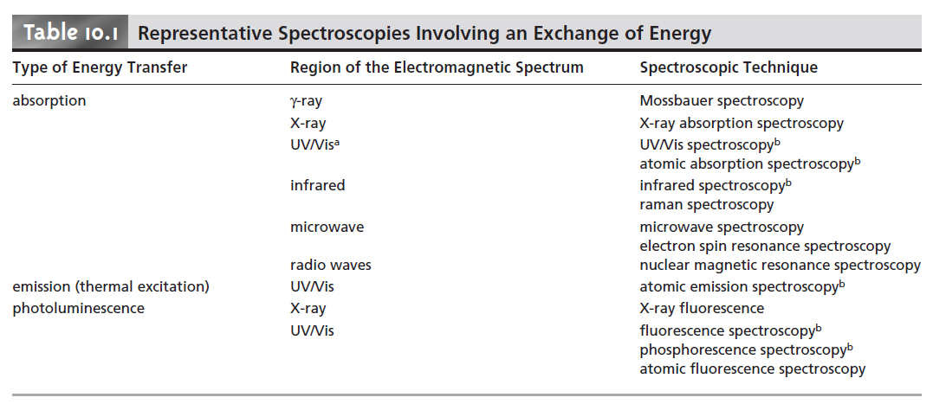

Slide 22
Basic Components of Spectroscopic Instrumentation
The instruments used in spectroscopy consist s of
a source of energy that can be input to the sample
a means for isolating a narrow range of wavelengths
a detector for measuring the signal
a signal processor to display the signal in a form convenient for the analyst.

Slide 23
Sources of Energy
All forms of spectroscopy require a source of energy.
In absorption and scattering spectroscopy this energy is supplied by photons.
Emission and luminescence spectroscopy use thermal, radiant (photon), or chemical energy to promote the analyte to a less stable, higher energy state.
Sources of Electromagnetic Radiation
Sources of electromagnetic radiation are classified as either continuum or line sources.
A continuum source emits radiation over a wide range of wavelengths, with a relatively smooth variation in intensity as a function of wavelength.
Line sources emit radiation at a few selected narrow wavelength ranges

Slide 24
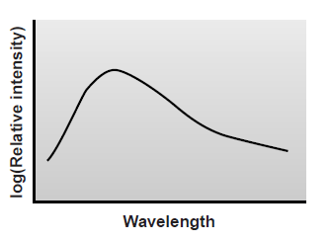
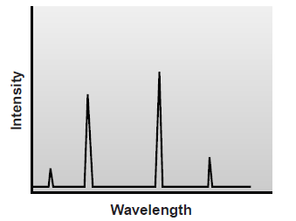
A continuum source
Line source

Slide 25
Sources of Thermal Energy
The most common sources of thermal energy are
flames and plasmas. Flame sources use the combustion of a fuel and an oxidant such as acetylene and air, to achieve temperatures of 2000–3400 K. Plasmas, which are hot, ionized gases, provide temperatures of 6000–10,000 K.
Chemical Sources of Energy
Exothermic reactions also may serve as a source of energy.
In chemiluminescence the analyte is raised to a higher-energy state by means of a chemical reaction, emitting characteristic radiation when it returns to a lower-energy state.
When the chemical reaction results from a biological or enzymatic reaction, the emission of radiation is called bioluminescence.
The flash of light from a firefly is an example of and bioluminescence

Slide 26
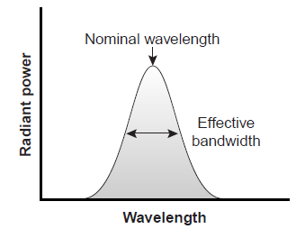
Wavelength Selection
A wavelength for analysis is selected where the analyte is the only absorbing species.
A single wavelength of radiation cannot be isolated from a continuum source.
Instead, a wavelength selector passes a narrow band of radiation characterized by a nominal wavelength, an effective bandwidth, and a maximum throughput of radiation.
The effective bandwidth is defined as the width of the radiation at half the maximum throughput.

Slide 27
Wavelength Selection
The ideal wavelength selector has a high throughput of radiation and a narrow effective bandwidth.
A high throughput is desirable because more photons pass through the wavelength selector, giving a stronger signal with less background noise.
A narrow effective bandwidth provides a higher resolution, with spectral features separated by more than twice the effective bandwidth being resolved.
Conditions favoring a higher throughput of radiation usually provide
less resolution. Decreasing the effective bandwidth improves resolution, but at the cost of a noisier signal.
For a qualitative analysis, resolution is generally more important than the throughput of radiation; thus, smaller effective bandwidths are desirable. In a quantitative analysis a higher throughput of radiation is usually desirable

Slide 28
Wavelength Selection Using Filters
Absorption filters work by selectively absorbing radiation from a narrow region of the electromagnetic spectrum.
Interference filters use constructive and destructive interference to isolate a narrow range of wavelengths.
A simple example of an absorption filter is a piece of colored glass.
A purple filter, for example, removes the complementary color green from 500–560 nm.
Commercially available absorption filters provide effective bandwidths from 30–250 nm. The maximum throughput for the smallest effective band passes, however, may be only 10% of the source’s emission intensity over that range of wavelengths.
Interference filters are more expensive than absorption filters, but
have narrower effective bandwidths, typically 10–20 nm, with maximum throughputs of at least 40%.

Slide 29
Wavelength Selection Using Monochromators
Absorption or interference filters do not allow for a continuous selection of wavelength.
If measurements need to be made at two wavelengths, then the filter must be changed in between measurements.
A further limitation is that filters are available for only selected nominal ranges of wavelengths. An alternative approach to wavelength selection, which provides for a continuous variation of wavelength, is the monochromator.

Slide 30
Wavelength Selection Using Monochromators
Radiation from the source enters the monochromator through an entrance slit.
The radiation is collected by a collimating mirror, which reflects a parallel beam of radiation to a diffraction grating.
The diffraction grating is an optically reflecting surface with a large number of parallel grooves .
Diffraction by the grating disperses the radiation in space, where a second mirror focuses the radiation onto a planar surface containing an exit slit.
Radiation exits the monochromator and passes to the detector.
A polychromatic source of radiation at the entrance slit is converted at the exit slit to a monochromatic source of finite effective bandwidth.

Slide 31
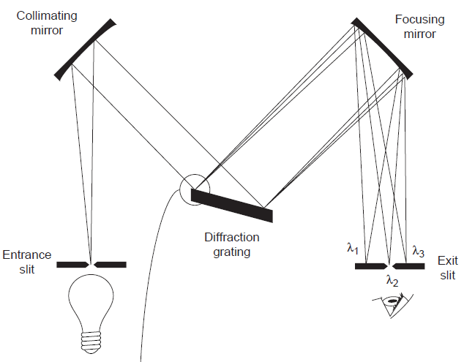
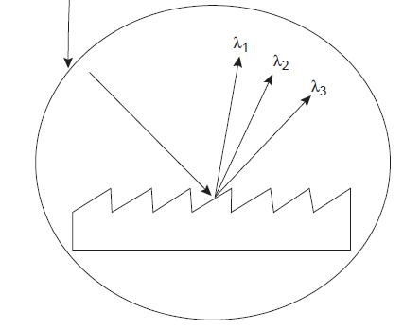
Operation of Monochromator

Slide 32
Wavelength Selection Using Monochromators
The choice of which wavelength exits the monochromator is determined by rotating the diffraction grating.
A narrower exit slit provides a smaller effective bandwidth and better resolution, but allows a smaller throughput of radiation.
Monochromators are classified as either fixed-wavelength or scanning.
In a fixed-wavelength monochromator, the wavelength is selected by manually rotating the grating.
Normally, a fixed-wavelength monochromator is only used for quantitative analyses where measurements are made at one or two wavelengths.
A scanning monochromator includes a drive mechanism that continuously rotates the grating, allowing successive wavelengths to exit from the monochromator.
Scanning monochromators are used to acquire spectra and, when operated in a fixedwavelength mode, for quantitative analysis.

Slide 33
Interferometer
An interferometer simultaneously allows source radiation of all wavelengths to reach the detector
Radiation from the source is focused on a beam splitter that transmits half of the radiation to a fixed mirror, while reflecting the other half to a movable mirror.
The radiation recombines at the beam splitter, where constructive and destructive interference determines, for each wavelength, the intensity of light reaching the detector.
As the moving mirror changes position, the wavelengths of light experiencing maximum constructive interference and maximum destructive interference also changes.
The signal at the detector shows intensity as a function of the moving mirror’s position, expressed in units of distance or time. The result is called an interferogram, or a time domain spectrum.

Slide 34
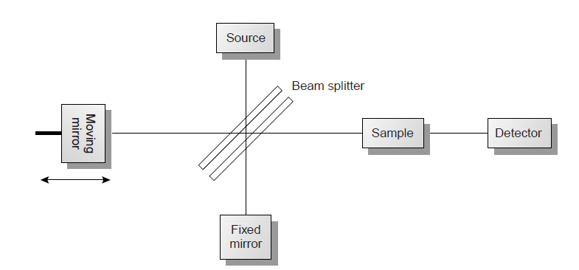
Interferometer

Slide 35
Interferometer
In comparison with a monochromator, interferometers provide two significant advantages.
  Higher throughput (Jacquinot’s advantage). Since an interferometer does not use slits and has fewer optical components from which radiation can be scattered and lost, the throughput of radiation reaching the detector is 80–200 times greater than that achieved with a monochromator. The result is an improved signal-to-noise ratio.
  Time savings(Fellgett’s advantage) All frequencies are monitored simultaneously, hence an entire spectrum can be recorded in approximately 1 s, as compared to 10–15 min with a scanning monochromator.

Slide 36
Detectors
Modern detectors use a sensitive transducer to convert a signal consisting of photons into an easily measured electrical signal.
Ideally the detector’s signal, S, should be a linear function of the electromagnetic radiation’s power, P,
S = kP + D
where k is the detector’s sensitivity, and D is the detector’s dark current, or the background electric current when all radiation from the source is blocked from the detector.

Slide 37
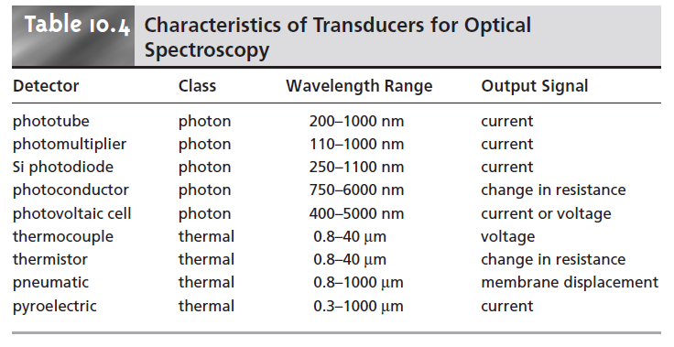
Detectors

Slide 38
Photon Transducers
Two general classes of transducers are used for optical
spectroscopy, photon detectors and thermal detectors
Phototubes and photomultipliers contain a photosensitive surface that absorbs radiation in the ultraviolet, visible, and near infrared (IR), producing an electric current proportional to the number of photons reaching the transducer.
Other photon detectors use a semiconductor as the photosensitive surface.
When the semiconductor absorbs photons, valence electrons move to the semiconductor’s conduction band, producing a measurable current.

Slide 39
Photon Transducers
One advantage of the Si photodiode is that it is easily miniaturized.
Groups of photodiodes may be gathered together in a linear array containing from 64 to 4096 individual photodiodes.
By placing a photodiode array along the monochromator’s
focal plane, it is possible to monitor simultaneously an entire range of wavelengths.

Slide 40
Thermal Transducers
Infrared radiation generally does not have sufficient energy
to produce a measurable current when using a photon transducer.
A thermal transducer, therefore, is used for infrared spectroscopy.
The absorption of infrared photons by a thermal transducer increases its temperature, changing one or more of its characteristic properties.
The pneumatic transducer, for example, consists of a small tube filled with xenon gas equipped with an IR-transparent window at one end, and a flexible membrane at the other end.
A blackened surface in the tube absorbs photons, increasing the temperature and, therefore, the pressure of the gas.
The greater pressure in the tube causes the flexible membrane
to move in and out, and this displacement is monitored to produce an electrical signal.

Slide 41
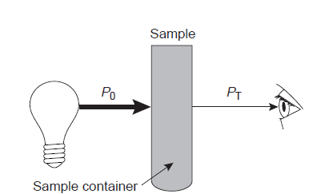
Transmittance and Absorbance
Transmittance is defined as the ratio of the electromagnetic radiation’s power exiting the sample, P_{T}, to that incident on the sample from the source, P₀
All methods of detection measure the transmittance of electromagnetic radiation.
Attenuation of radiation as it passes through the sample leads to a transmittance of less than 1.

Slide 42
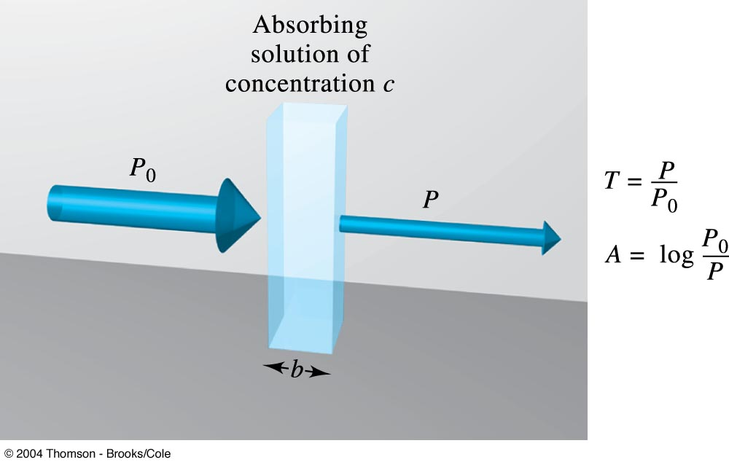
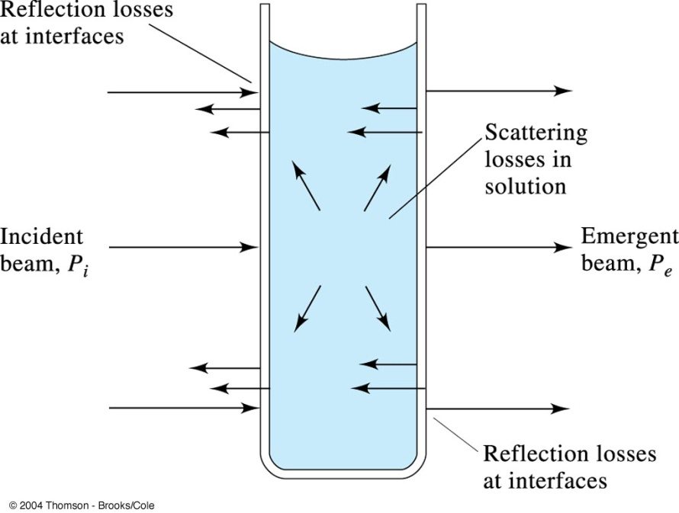
Attenuation of a beam of radiation by an absorbing solution.
Reflection and scattering losses with a solution contained in a typical glass cell.

Slide 43
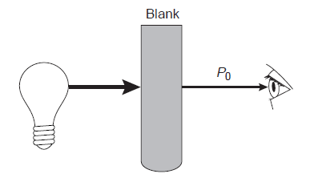
Besides absorption by the analyte, several additional phenomena contribute to the net attenuation of radiation, including reflection and absorption by the sample container, absorption by components of the sample matrix other than the analyte, and the scattering of radiation.
To compensate for this loss of the electromagnetic radiation’s power, a method blank is used .
The radiation’s power exiting from the method blank is taken to be P₀.

Slide 44

Absorbance
An alternative method for expressing the attenuation of electromagnetic radiation is absorbance, A, which is defined as
Absorbance is the more common unit for expressing the attenuation of radiation because it is a linear function of the
analyte’s concentration.

Slide 45
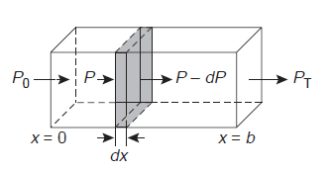



Beer’s Law
When monochromatic electromagnetic radiation passes through an infinitesimally thin layer of sample, of thickness dx, it experiences a decrease in power of dP.
The fractional decrease in power is proportional
to the sample’s thickness and the analyte’s concentration.
where P is the power incident on the thin layer of sample, and α is a proportionality constant. Integrating,

Slide 46


Beer’s Law
Converting from ln to log, and substituting for P₀/P_{T}
where a is the analyte’s absorptivity with units of cm^{–1} conc^{–1}.
When concentration is expressed using molarity, the absorptivity is replaced by the molar absorptivity, ε (units cm^{–1} M^{–1})
The absorptivity and molar absorptivity give, in effect, the probability that the analyte will absorb a photon of given energy.
As a result, values for both a and ε depend on the wavelength of electromagnetic radiation.
Beer’s law

Slide 47
Limitations to Beer’s Law
Calibration curves of absorbance versus concentration are found to be nonlinear in many cases. Deviations from linearity are due to the following:
Beer’s law is a limiting law that is valid only for low concentrations of analyte.
At higher concentrations the individual particles of analyte no longer behave independently of one another.
The resulting interaction between particles of analyte may change the value of ε.
Also the absorptivity, a, and molar absorptivity, ε, depend on the sample’s refractive index. Since the refractive index varies with the analyte’s concentration, the values of a and ε will change.
For sufficiently low concentrations of analyte, the refractive index remains essentially constant, and the calibration curve is linear.

Slide 48
Chemical Limitations
Chemical deviations from Beer’s law can occur when the absorbing species is involved in an equilibrium reaction.
The presence of the other forms of the analyte alters the total radiation absorbed and causes deviation from Beer’s law.
For example consider a solution of a weak acid and it’s conjugate base

Slide 49
Instrumental Limitations
There are two principal instrumental limitations to Beer’s law.
The first limitation is that Beer’s law is strictly valid for purely monochromatic radiation; that is, for radiation consisting of only one wavelength.
However, even the best wavelength selector passes radiation with a small, but finite effective bandwidth.
Polychromatic radiation always gives a negative deviation from Beer’s law, but is minimized if the value of ε is essentially constant over the wavelength range passed by the wavelength selector.

Slide 50

Instrumental Limitations
The second limitation is stray radiation
Stray radiation arises from imperfections within the wavelength selector that allows extraneous light to “leak” into the instrument. Stray radiation adds an additional contribution, P_{stray}, to the radiant power reaching the detector
For small concentrations of analyte, P_{stray} is significantly smaller than P₀ and P_{T}, and the absorbance is unaffected by the stray radiation.
At higher concentrations of analyte, however, P_{stray} is no longer significantly smaller than P_{T} and the absorbance is
smaller than expected. The result is a negative deviation from Beer’s law

Slide 51
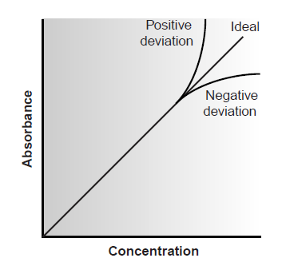
Deviations from Beer’s law

Slide 52
Ultraviolet-Visible and Infrared Spectrophotometry
In colourimetry, visible light was absorbed by a sample and the
concentration of analyte was determined visually by comparing the sample’s colour .
The technique was limited by the tedious nature of making visual color comparisons.
Modern instrumentation consists of the application of photoelectric transducers for ultraviolet and visible radiation, and thermocouples for infrared radiation.
The simplest instrument currently used for molecular UV/Vis absorption is the filter photometer

Slide 53
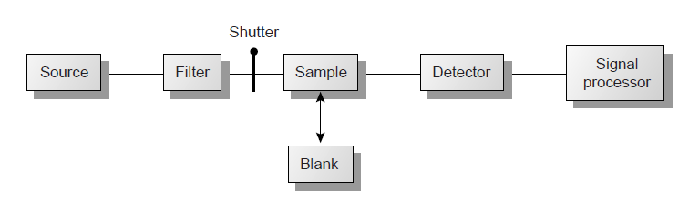
filter photometer
It uses an absorption or interference filter to isolate a band of radiation.
The filter is placed between the source and sample to prevent the sample from decomposing when exposed to high-energy radiation.
A filter photometer has a single optical path between the source and detector and is called a single-beam instrument.

Slide 54
filter photometer
The instrument is calibrated to 0% T while using a shutter to block the source radiation from the detector.
After removing the shutter, the instrument is calibrated to 100% T using an appropriate blank.
The blank is then replaced with the sample, and its transmittance is measured.
Since the source’s incident power and the sensitivity of the detector vary with wavelength, the photometer must be recalibrated whenever the filter is changed.
Photometers are relatively inexpensive, rugged, and easy to maintain. They are also highly portable and useful for conducting spectroscopic analyses in the field.
A disadvantage of a photometer is that it cannot be used to obtain an absorption spectrum.

Slide 55
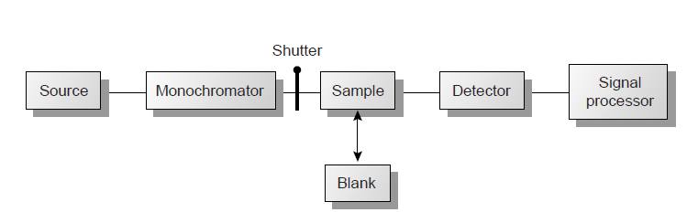
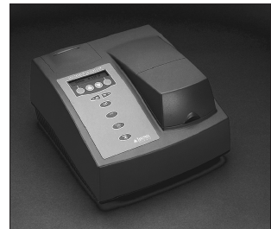
Spectrophotometers
This instrument uses a monochromator for wavelength selection.
The simplest spectrophotometer is a single-beam instrument equipped with a fixed wavelength monochromator.
They are not practical for recording spectra since manually adjusting the wavelength and recalibrating the spectrophotometer is awkward and time-consuming.
In addition, the accuracy of a single-beam spectrophotometer is limited by the stability of its source and detector over time.

Slide 56
Spectrophotometers
The limitations of fixed-wavelength, single-beam spectrophotometers are minimized by using the double-beam in-time spectrophotometer
A chopper controls the radiation’s path, alternating it between the sample, the blank, and a shutter.
The signal processor uses the chopper’s known speed of rotation to resolve the signal reaching the detector into that due to the transmission of the blank (P₀) and the sample (P_{T}).
The effective bandwidth of a double-beam spectrophotometer is controlled by means of adjustable slits at the entrance and exit of the monochromator.
Effective bandwidths of between 0.2 nm and 3.0 nm are common.
A scanning monochromator allows for the automated recording of spectra.

Slide 57
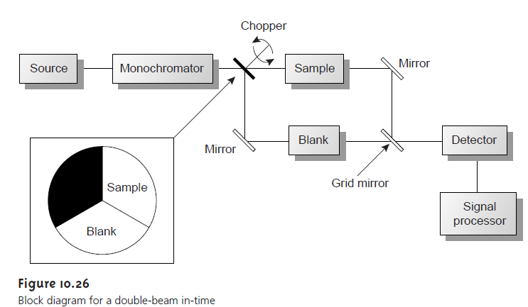
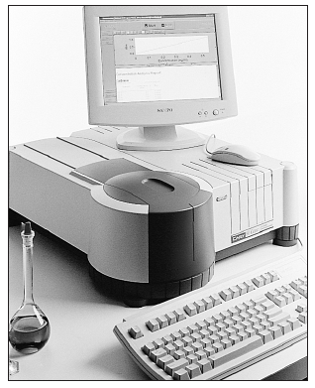

Slide 58
Spectrophotometers
Double-beam instruments are more versatile than single-beam instruments, being useful for both quantitative and qualitative analyses.
They are more expensive than single-beam instruments
A linear photodiode array consists of multiple detectors, or channels, allowing an entire spectrum to be recorded in as little as 0.1 s.
Source radiation passing through the sample is dispersed by a grating.
The linear photodiode array is situated at the grating’s focal plane, with each diode recording the radiant power over a narrow range of wavelengths.

Slide 59
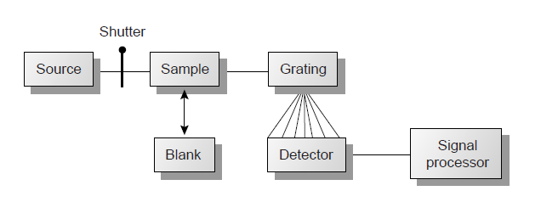
photodiode array spectrophotometer

Slide 60
photodiode array spectrophotometer
An advantage of a linear photodiode array is the speed of data acquisition, which makes it possible to collect several spectra for a single sample.
Individual spectra are added and averaged to obtain the final spectrum.
This process of signal averaging improves a spectrum’s signal-to-noise ratio.
One disadvantage of a linear photodiode array is that the effective bandwidth per diode is roughly an order of magnitude larger than that obtainable with a high-quality monochromator.
The sample compartment provides a light-tight environment that prevents the loss of radiation, as well as the addition of stray radiation.

Slide 61
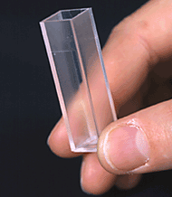
Sample preparation
Samples are normally in the liquid or solution state and are placed in cells constructed with UV/Vis-transparent materials, such as quartz, glass, and plastic
Quartz or fused-silica cells are required when working at wavelengths of less than 300 nm where other materials show a significant absorption.
The most common cell has a path length of 1 cm. The highest quality cells are constructed in a rectangular shape, allowing the radiation to strike the cell at a 90° angle, where losses to reflection are minimal.

Slide 62

Infrared Spectra
The energy of infrared radiation is sufficient to produce a change in the vibrational energy of a molecule or polyatomic ion
Vibrational energy levels are quantized; that is, a molecule may have only certain, discrete vibrational energies.
The energy for allowed vibrational modes, E_{ν}, is
where ν is the vibrational quantum number, which may take values of 0, 1, 2, . . ., and ν₀ is the bond’s fundamental vibrational frequency.
Values for ν₀ are determined by the bond’s strength and the mass at each end of the bond and are characteristic of the type of bond.

Slide 63
Infrared Spectra
A carbon–carbon single bond (C—C) absorbs infrared radiation at a lower energy than a carbon–carbon double bond (C=C) because a C—C bond is weaker than a C=C bond.
At room temperature most molecules are in their ground vibrational state (v = 0).
A transition from the ground vibrational state to the first vibrational excited state (v = 1) requires the absorption of a photon with an energy of hν₀.
Transitions in which Δv is ±1 give rise to the fundamental absorption lines.
Weaker absorption lines, called overtones, are due to transitions
in which Δv is ±2 or ±3.

Slide 64
Infrared Spectra
The number of possible normal vibrational modes for a linear molecule is 3N – 5, and for a nonlinear molecule is 3N – 6, where N is the number of atoms in the molecule.
Infrared spectra often show a considerable number of absorption bands.
Even a relatively simple molecule, such as benzene (C₆H₆), for example, has 30 possible normal modes of vibration, although
not all of these vibrational modes give rise to an absorption.

Slide 65
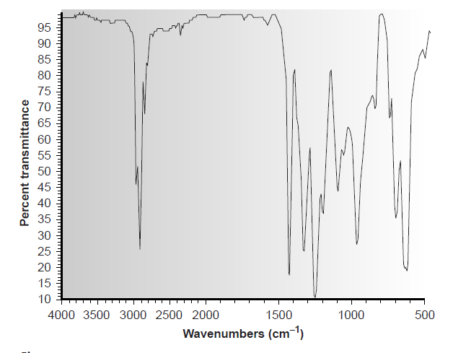
Infrared Spectra

Slide 66
IR Spectroscopy
The instrument for IR absorption spectroscopy is similar to the filter photometer for UV/Vis absorption.
These instruments have the advantage of portability and typically are used as dedicated analyzers for gases such as HCN and CO.
Infrared instruments using a monochromator for wavelength selection are constructed using double-beam optics
Double-beam optics are preferred over single-beam optics because the sources and detectors for infrared radiation are less stable than that for UV/Vis radiation.
In addition, it is easier to correct for the absorption of infrared radiation by atmospheric CO₂ and H₂O vapor when using double-beam optics.

Slide 67
IR Spectroscopy
In a Fourier transform infrared spectrometer or FT–IR, the monochromator is replaced with an interferometer .
Because an FT–IR includes only a single optical path, it is necessary to collect a separate spectrum to compensate for the absorbance of atmospheric CO₂ and H₂O vapor.
This is done by collecting a background spectrum without the sample and storing the result in the instrument’s computer memory. The background spectrum is removed from the sample’s spectrum by taking a ratio of the two signals.
In comparison to other IR instruments, an FT–IR provides for rapid data acquisition, allowing an enhancement in signal-to-noise
ratio through signal averaging.

Slide 68
Quantitative Applications
The determination of an analyte’s concentration based on its absorption of ultraviolet or visible radiation is one of the most frequently encountered quantitative analytical methods.
One reason for its popularity is that many organic and inorganic compounds have strong absorption bands in the UV/Vis region of the electromagnetic spectrum.
In addition, analytes that do not absorb UV/Vis radiation, or that absorb such radiation only weakly, frequently can be chemically coupled to a species that does.
An additional advantage to UV/Vis absorption is that in most cases it is relatively easy to adjust experimental and instrumental conditions so that Beer’s law is obeyed.

Slide 69
Quantitative Applications
Quantitative analyses based on the absorption of infrared radiation, although important, are less frequently encountered than those for UV/Vis absorption.
One reason is the greater tendency for instrumental deviations from Beer’s law when using infrared radiation. Since infrared absorption bands are relatively narrow, deviations due to the lack of monochromatic radiation are more pronounced.
In addition, infrared sources are less intense than sources of UV/Vis radiation, making stray radiation more of a problem.

Slide 70

Quantitative Analysis of Mixtures
The analysis of two or more components in the same sample is straightforward if there are regions in the sample’s spectrum in
which each component is the only absorbing species.
In this case each component can be analyzed as if it were the only species in solution.
Unfortunately, UV/Vis absorption bands are so broad that it frequently is impossible to find appropriate wavelengths at which each component of a mixture absorbs separately.
For a two-component mixture of X and Y, the mixture’s absorbance, Am, at a wavelength λ₁ is

Slide 71

Quantitative Analysis of Mixtures
If the absorbance is measured at a second wavelength,
C_{X} and C_{Y} can be determined by solving the two equations together.
It is necessary to determine values for ε for each component at both wavelengths.
In general, for a mixture of n components, the absorbance must be measured at n different wavelengths.

Slide 72
Qualitative Applications
Ultraviolet, visible and infrared absorption bands result from the absorption of electromagnetic radiation by specific valence electrons or bonds.
The energy at which the absorption occurs, as well as the intensity
of the absorption, is determined by the chemical environment of the absorbing species.
Several rules have been developed to aid in correlating UV/Vis absorption bands to chemical structure
For example, benzene has several ultraviolet absorption bands due to π π* transitions. The position and intensity of two of these bands, 203.5 nm (ε = 7400) and 254 nm (ε = 204), are very sensitive to substitution.
For benzoic acid, in which a carboxylic acid group replaces one of the aromatic hydrogens, the two bands shift to 230 nm (ε = 11,600) and 273 nm (ε = 970).

Slide 73
Qualitative Applications
Similar correlations have been developed for determining structures using infrared absorption bands.
For example the carbonyl, C=O, stretch is very sensitive to adjacent functional groups, occurring at 1650 cm^{–1} for acids, 1700 cm^{–1} for ketones, and 1800 cm^{–1} for acid chlorides.
When a spectrum of an unknown compound is obtained, its identity can often be determined by searching through a library of reference spectra. This process is known as spectral searching.

Slide 74
Atomic Absorption Spectroscopy
The most important difference between a spectrophotometer for atomic absorption and one for molecular absorption is the need to convert the analyte into a free atom.
The process of converting an analyte in solid, liquid, or solution form to a free gaseous atom is called atomization.
Two general methods of atomization are used: flame atomization and electrothermal atomization.

Slide 75
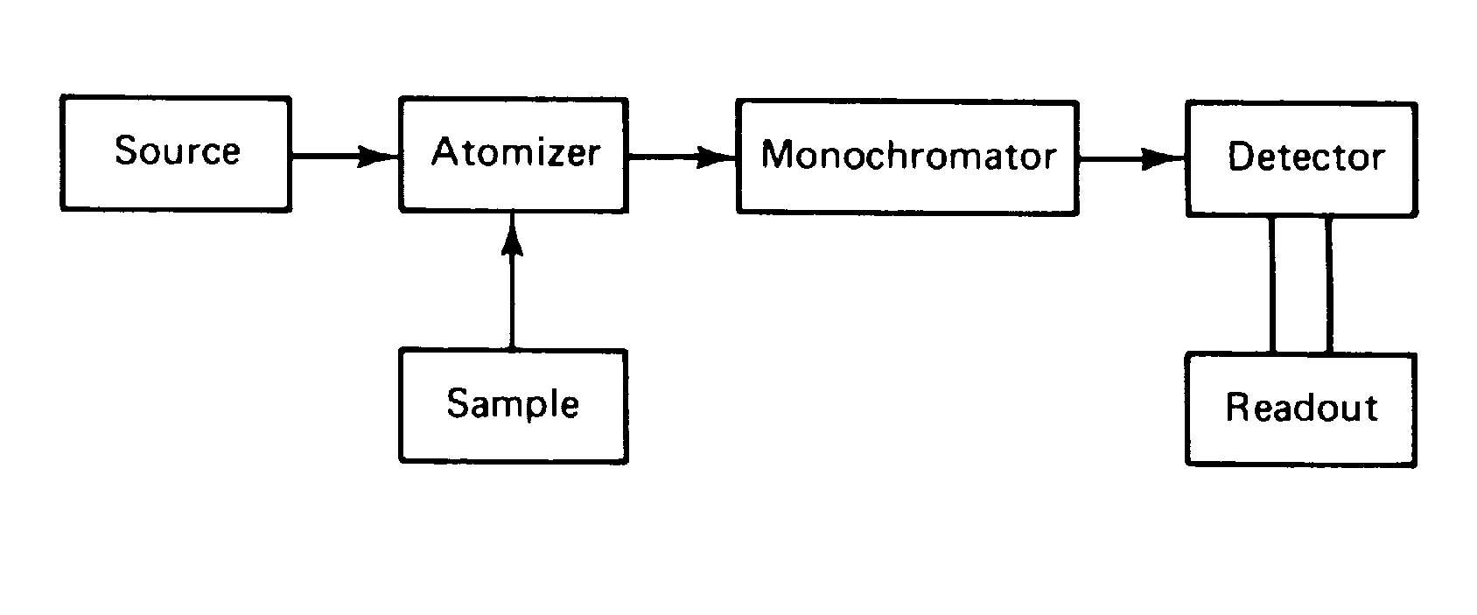
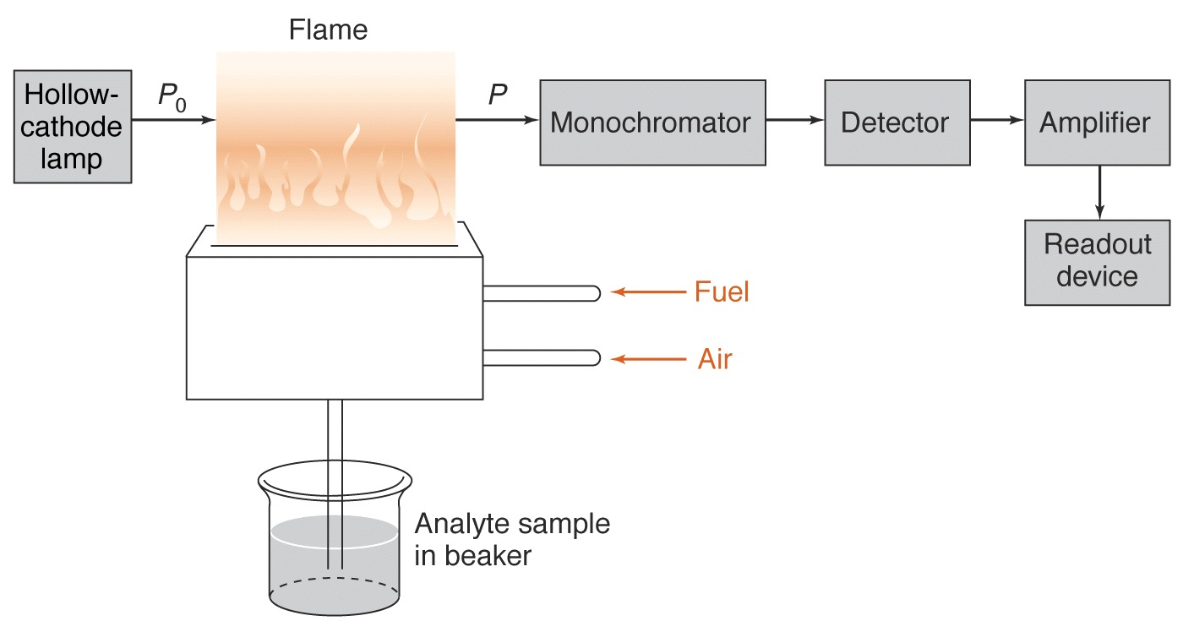
Basic components of an atomic spectrophotometer

Slide 76
Flame Atomizers
In flame atomization the sample is first converted into a fine mist consisting of small droplets of solution.
This is accomplished using a nebulizer assembly
The sample is aspirated into a spray chamber by passing a high-pressure stream consisting of one or more combustion gases, past the end of a capillary tube immersed in the sample.
The impact of the sample with the glass impact bead produces an aerosol mist.
The aerosol mist mixes with the combustion gases in the spray chamber before passing to the burner where the flame’s thermal energy desolvates the aerosol mist to a dry aerosol of small, solid particles.
Subsequently, thermal energy volatilizes the particles, producing
a vapor consisting of molecular species, ionic species, and free atoms.

Slide 77
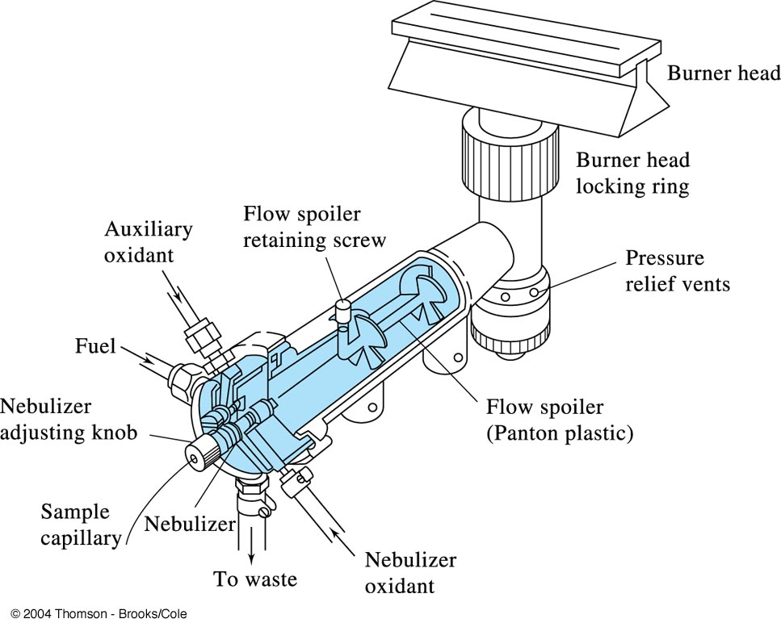
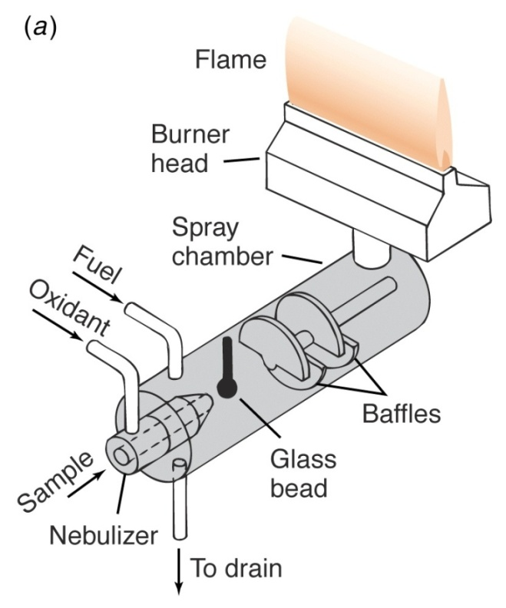
Flame atomization : the laminar flow burner

Slide 78
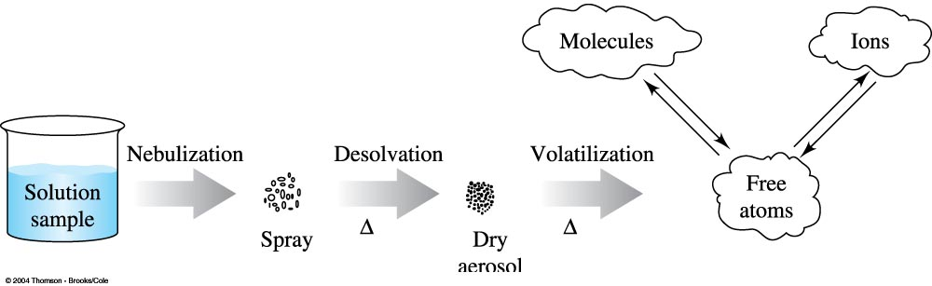
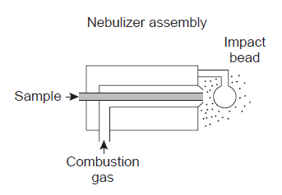

Slide 79
Flame Atomizers
Thermal energy in flame atomization is provided by the combustion of a fuel–oxidant mixture.
Common fuels and oxidants are air–acetylene and nitrous oxide-acetylene flames are used most frequently.
Normally, the fuel and oxidant are mixed in an approximately
stoichiometric ratio; however, a fuel-rich mixture may be desirable for atoms that are easily oxidized.

Slide 80
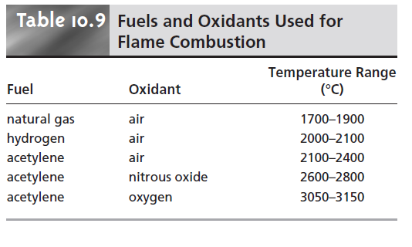

Slide 81
The burner
The most common design for the burner is the slot burner
This burner provides a long path length for monitoring absorbance and a stable flame.
The burner is mounted on an adjustable stage that allows the entire burner assembly to move horizontally and vertically.
Horizontal adjustment is necessary to ensure that the flame is aligned with the instrument’s optical path.
Vertical adjustments are needed to adjust the height within the flame from which absorbance is monitored.
This is important because two competing processes affect the concentration of free atoms in the flame.

Slide 82
The burner
An increased residence time in the flame results in a greater atomization efficiency; thus, the production of free atoms increases with height.
On the other hand, longer residence times may lead to the formation of metal oxides that absorb at a wavelength different from that of the atom.
For easily oxidized metals, such as Cr, the concentration of free atoms is greatest just above the burner head.
For metals, such as Ag, which are difficult to oxidize, the concentration of free atoms increases steadily with height
Other atoms show concentration profiles that maximize at a characteristic height.

Slide 83
Sample introduction
The most common means for introducing samples into a flame atomizer is continuous aspiration
The sample is continuously passed through the burner while monitoring the absorbance.
Continuous aspiration is sample intensive, typically requiring 2–5 mL of sample.
Flame microsampling provides a means for introducing a discrete sample of fixed volume and is useful when the volume of sample is limited or when the sample’s matrix is incompatible with the flame atomizer.
For example, the continuous aspiration of a sample containing
a high concentration of dissolved solids, such as sea water, may result in the build-up of solid deposits on the burner head.

Slide 84
Sample introduction
These deposits partially obstruct the flame, lowering the absorbance.
Flame microsampling is accomplished using a micropipet to place 50–250 mL of sample in a Teflon funnel connected to the
nebulizer, or by dipping the nebulizer tubing into the sample for a short time.
Dip sampling is usually accomplished with an automatic sampler.
The signal for flame microsampling is a transitory peak whose height or area is proportional to the amount of analyte that is injected.
The principal advantage of flame atomization is the reproducibility with which the sample is introduced into the spectrophotometer.

Slide 85
Disadvantages of flame atomizers
The efficiency of atomization may be quite poor.
The majority of the aerosol mist produced during nebulization
consists of droplets that are too large to be carried to the flame by the combustion gases.
Consequently, as much as 95% of the sample never reaches the flame.
A second reason for poor atomization efficiency is that the large volume of combustion gases significantly dilutes the sample.
Together, these contributions to the efficiency of atomization reduce sensitivity since the analyte’s concentration in the
flame may be only 2.5 x 10^{–6} of that in solution.

Slide 86
Electrothermal Atomizers
A significant improvement in sensitivity is achieved by
using resistive heating in place of a flame.
A typical electrothermal atomizer, also known as a graphite furnace, consists of a cylindrical graphite tube approximately 1–3 cm in length, and 3–8 mm in diameter
The graphite tube is housed in an assembly that seals the ends of the tube with optically transparent windows.
The assembly also allows for the passage of a continuous stream of inert gas, protecting the graphite tube from oxidation, and removing the gaseous products produced during atomization.
A power supply is used to pass a current through the
graphite tube, resulting in resistive heating.

Slide 87
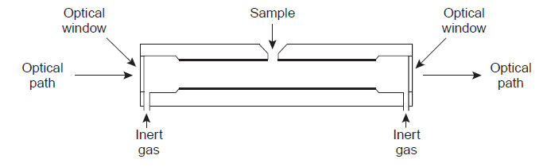
Electrothermal Atomizers

Slide 88
Electrothermal Atomizers
Samples are injected into the graphite tube through a small-diameter hole located at the top of the tube.
Atomization is achieved in three stages.
In the first stage the sample is dried using a current that raises the temperature of the graphite tube to about 110 °C. Desolvation leaves the sample as a solid residue.
In the second stage, which is called ashing, the temperature is increased to 350–1200 °C. At these temperatures, any organic material in the sample is converted to CO₂ and H₂O, and volatile inorganic materials are vaporized. These gases are removed by the inert gas flow.
In the final stage the sample is atomized by rapidly increasing the temperature to 2000–3000 °C. The result is a transient absorbance peak whose height or area is proportional to the absolute amount of analyte injected into the graphite tube.

Slide 89
Electrothermal Atomizers
Atomization efficiency is strongly influenced by the sample’s contact with the graphite tube, which is difficult to control reproducibly.
Electrothermal atomization provides a significant improvement in sensitivity by trapping the gaseous analyte in the small volume of the graphite tube.
The analyte’s concentration in the resulting vapor phase may be as much as 1000 times greater than that produced by flame atomization.
The improvement in sensitivity, and the resulting improvement in detection limits, is offset by a significant decrease in precision.

Slide 90
Flame Versus Electrothermal Atomization
The choice of atomization method is determined primarily by the analyte’s concentration in the samples being analyzed.
The detection limits for most elements are significantly lower when using electrothermal atomization .
A better precision when using flame atomization makes it the method of choice when the analyte’s concentration is significantly greater than the detection limit for flame atomization.
In addition, flame atomization is subject to fewer interferences, allows for a greater throughput of samples, and requires less expertise from the operator.
Electrothermal atomization is the method of choice when the analyte’s concentration is lower than the detection limit for flame atomization.
Electrothermal atomization is also useful when the volume of sample is limited.

Slide 91
Radiation source of atomic absorption
The source for atomic absorption is a hollow cathode lamp consisting of a cathode and anode enclosed within a glass tube filled with a low pressure of Ne or Ar
When a potential is applied across the electrodes, the filler gas is ionized. The positively charged ions collide with the negatively charged cathode, dislodging, or “sputtering,” atoms from the cathode’s surface.
Some of the sputtered atoms are in the excited state and emit radiation characteristic of the metal from which the cathode was manufactured.
By fashioning the cathode from the metallic analyte, a hollow cathode lamp provides emission lines that correspond to the analyte’s absorption spectrum.

Slide 92
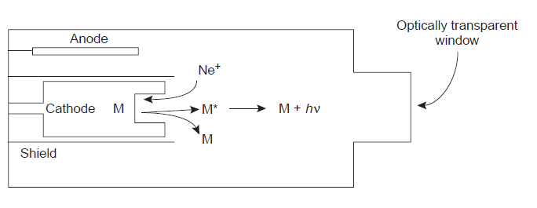
Hollow cathode lamp

Slide 93
Sensitivity
The sensitivity of an atomic absorption line is often described by its characteristic concentration, which is the concentration of analyte giving an absorbance of 0.00436 (corresponding to a percent transmittance of 99%).
Usually the wavelength providing the best sensitivity is used, although a less sensitive wavelength may be more appropriate for a high concentration of analyte.
A less sensitive wavelength also may be appropriate when significant interferences occur at the most sensitive wavelength.
For example, atomizing a sample produces atoms of not only the analyte, but also of other components present in the sample’s matrix.

Slide 94
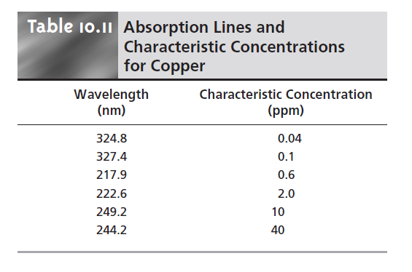

Slide 95
Interference and deviations
The presence of other atoms in the flame does not result in an interference unless the absorbance lines for the analyte and the potential interferant are within approximately 0.01 nm.
An interference may be avoided by selecting another wavelength at which the analyte, but not the interferant, absorbs.
The emission spectrum from a hollow cathode lamp includes, besides emission lines for the analyte, additional emission lines for impurities present in the metallic cathode and the filler gas.
These additional lines serve as a potential source of stray
radiation that may lead to an instrumental deviation from Beer’s law.
Normally the monochromator’s slit width is set as wide as possible, improving the throughput of radiation, while being narrow enough to eliminate this source of stray radiation.

Slide 96
Sample Preparation
Flame and electrothermal atomization require that the sample be in a liquid or solution form. Solids are dissolved in an appropriate solvent.
When the sample is not soluble, it may be digested, either on a hot plate or by microwave, using HNO₃, H₂SO₄, or HClO₄. Alternatively, the analyte may be extracted via a Soxhlet extraction.
Liquid samples may be analyzed directly or may be diluted or extracted if the matrix is incompatible with the method of atomization.
Serum samples, for instance, may be difficult to aspirate when using flame atomization and may produce unacceptably high background absorbances when using electrothermal atomization.

Slide 97
Spectral Interference
A spectral interference occurs when an analyte’s absorption line overlaps with an interferant’s absorption line or band.
The overlap of two atomic absorption lines is seldom a problem. On the other hand, a molecule’s broad absorption band or the scattering of source radiation is a potentially serious spectral interference.
The products of combustion consist of molecular species that may exhibit broad-band absorption, as well as particulate material that may scatter radiation from the source.
If not corrected, then the intensity of the transmitted radiation decreases.

Slide 98
Spectral Interference
The result is an apparent increase in the sample’s absorbance.
Absorption and scattering of radiation by the flame are corrected by analyzing a blank.
Spectral interferences also occur when components of the sample’s matrix react in the flame to form molecular species, such as oxides and hydroxides.
Absorption and scattering due to components in the sample matrix other than the analyte constitute the sample’s background and may present a significant problem, particularly at wavelengths below 300 nm, at which the scattering of radiation becomes more important.
If the composition of the sample’s matrix is known, then standards can be prepared with an identical matrix. In this case the background absorption is the same for both the samples and standards.

Slide 99
Spectral Interference
Alternatively, if the background is due to a known matrix component, then that component can be added in excess to all samples and standards so that the contribution of the naturally occurring interferant is insignificant.
Many interferences due to the sample’s matrix can also be eliminated by adjusting the flame’s composition.
For example, by switching to a higher temperature flame it may be possible to prevent the formation of interfering oxides and hydroxides.
When the identity of the matrix interference is unknown, or when it is impossible to adjust the flame to eliminate the interference, then other means must be used to compensate for the background interference.

Slide 100
Spectral Interference
One of the most common methods for background correction is the use of a continuum source, such as a D₂ lamp.
Since the D₂ lamp is a continuum source, the absorbance of its radiation by the analyte’s narrow absorption line is negligible.
Any absorbance of radiation from the D₂ lamp, therefore, is due to the background.
Absorbance of radiation from the hollow cathode lamp, however, is due to both the analyte and the background. Subtracting the absorbance for the D₂ lamp from that for the hollow cathode lamp gives an absorbance that has been corrected for the background interference.

Slide 101
Spectral Interference
The method assumes that the background absorbance is constant over the range of wavelengths passed by the monochromator.
When this is untrue, subtracting the two absorbances may under- or over-correct for the background.

Slide 102
Chemical Interferences
The quantitative analysis of some elements is complicated by chemical interferences occurring during atomization.
The two most common chemical interferences are the formation of nonvolatile compounds containing the analyte and ionization of the analyte.
One example of a chemical interference due to the formation of nonvolatile compounds is observed when PO₄^{3–} or Al³⁺ is added to solutions of Ca²⁺.
In one study, for example, adding 100 ppm Al³⁺ to a solution of 5 ppm Ca²⁺ decreased the calcium ion’s absorbance from 0.50 to 0.14, whereas adding 500 ppm PO₄^{3–} to a similar solution of Ca²⁺ decreased the absorbance from 0.50 to 0.38.21
These interferences were attributed to the formation of refractory particles of Ca₃(PO₄)₂ and an Al–Ca–O oxide.

Slide 103
Chemical Interferences
The formation of nonvolatile compounds often can be minimized by increasing the temperature of the flame, either by changing the fuel-to-oxidant ratio or by switching to a different combination of fuel and oxidant.
Another approach is to add a releasing agent or protecting agent to solutions containing the analyte.
A releasing agent is a species whose reaction with the interferent is more favorable than that of the analyte. Adding Sr²⁺ or La³⁺ to solutions of Ca²⁺, for example, minimizes the effect of PO₄^{3–} and Al³⁺ by reacting in place of the analyte.

Slide 104
Chemical Interferences
Protecting agents react with the analyte to form a stable volatile complex.
Adding 1% w/w EDTA to the Ca²⁺/PO₄^{3–} solution discussed in the preceding paragraph gave an absorbance of 0.52, compared with an absorbance of 0.55 for just the Ca²⁺ and EDTA.
On the other hand, EDTA does not serve as a protecting agent for solutions of Ca²⁺ and Al³⁺.

Slide 105

Ionization interference
Ionization interferences occur when thermal energy from the flame or electrothermal atomizer is sufficient to ionize the analyte
where M is the analyte in atomic form, and M⁺ is the cation of the analyte formed by ionization. Since the absorption spectra for M and M⁺ are different, the position of the equilibrium affects absorbance at wavelengths where M absorbs.
If another species is present that ionizes more easily than M, then the equilibrium shifts to the left because of their low ionization energy.

Slide 106
Ionization interference
Variations in the concentration of easily ionized species, therefore, may have a significant effect on a sample’s absorbance, resulting in a determinate error.
The effect of ionization can be minimized by adding a high concentration of an ionization suppressor, which is simply another species that ionizes more easily than the analyte.
If the concentration of the ionization suppressor is sufficient, then the increased concentration of electrons in the flame pushes reaction the left, preventing the analyte’s ionization.
Potassium and cesium are frequently used as ionization suppressors

Slide 107
Standardizing the Method
Because Beer’s law also applies to atomic absorption, we might expect atomic absorption calibration curves to be linear.
In practice, however, most atomic absorption calibration curves are nonlinear, or linear for only a limited range of concentrations.
Nonlinearity in atomic absorption is a consequence of instrumental limitations, including stray radiation from the hollow cathode lamp and a nonconstant molar absorptivity due to the narrow width of the absorption line.
Nonlinear calibration curves may be fit using quadratic and cubic equations, although neither works well over a broad range of concentrations.

Slide 108
Standardizing the Method
When possible, a quantitative analysis is best conducted using external standards.
Unfortunately, matrix interferences are a frequent problem, particularly when using electrothermal atomization.
For this reason the method of standard additions is often used.
One limitation to this method of standardization, however, is the requirement that there be a linear relationship between absorbance and concentration

Slide 109
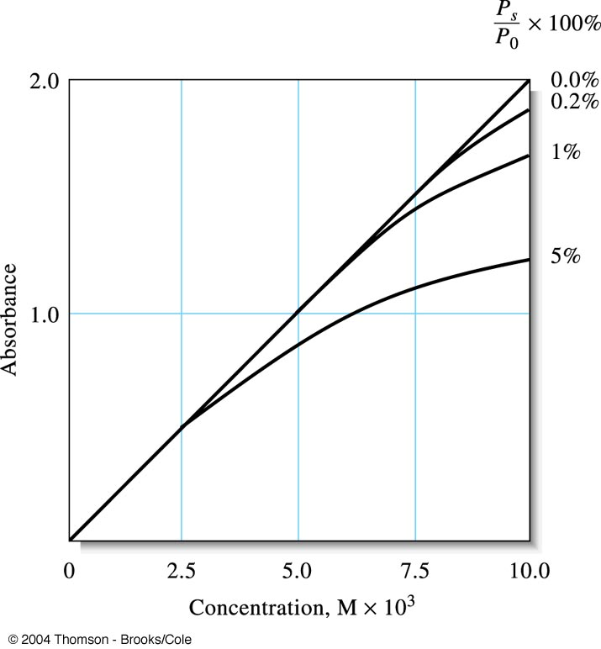

Absorbance error introduced by different levels of stray light.
Deviation from Beer’s law caused by various levels of stray light.

